Slide 1

GROUP 3 – FINANCIAL ANALYSIS
WHICH IS THE BEST SUPERMARKET FOR US TO INVEST IN?
Group Members:
Alex
Murali
Eleanor
Devon
Archie
Vavara
Zainab
Ayesha

Slide 2
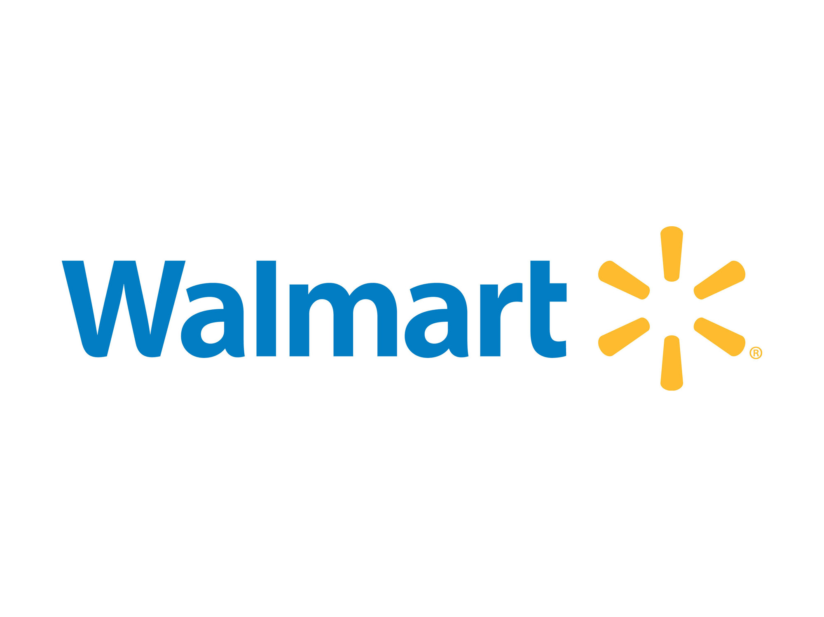

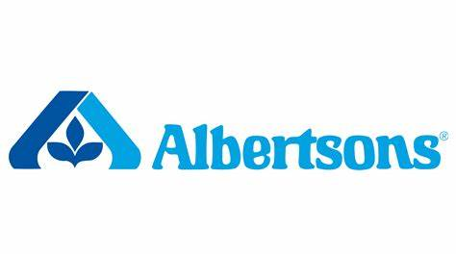
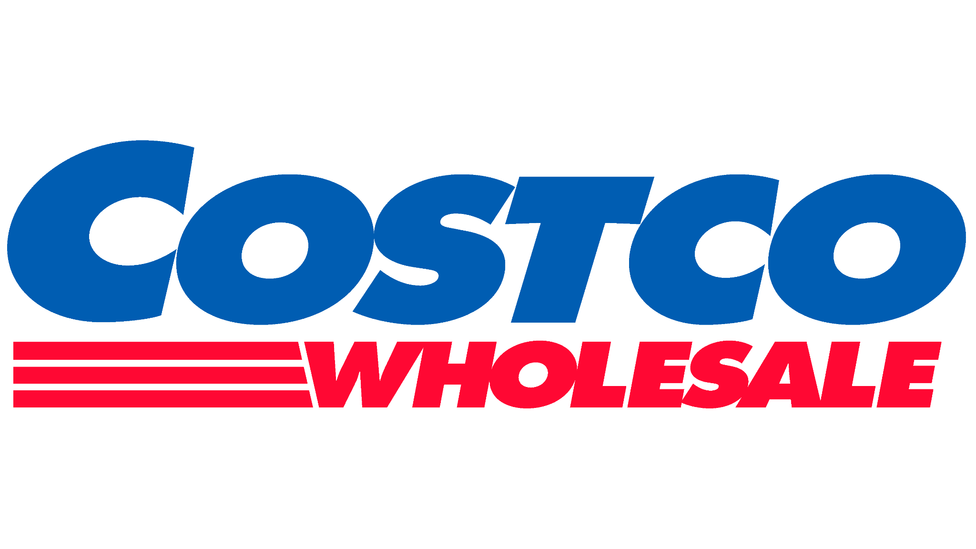
WHICH IS THE BEST SUPERMARKET FOR US TO INVEST IN?
Investment returns:
Increase in the Share Price ⬆
Increase in Dividends ⬆
Decision Aid:
6 Questions

Slide 3

METHODOLOGY
Data Source
Data Items
Date
Opening Stock Price
Closing Stock Price
Stock Volume Traded
Dividends

Slide 4
METHODOLOGY
The four big supermarkets in the U.S. are Walmart, Costco, Target and Albertsons.
Data was sourced from Yahoo Finance. Share price and dividend data was readily available – thank you Chace!
We did initially try to use the NASDAQ API key but found that we were limited to 14 lines of data –which we felt was not enough.
Information initially looked for: Opening Stock Price
Closing Stock Price
Stock Volume Traded
Time
This then evolved into incorporating dividends.

Slide 5
WHAT DO INVESTORS LOOK FOR?
Simple – a return on their investment!
Investors make money by a combination of dividend payments and (theoretically) selling their stock at a higher price than what they brought it for.
Factors to consider: Overall increase in stock price
Amount and frequency of dividend payouts
Volatility
Company specific factors
Industry / legislative factors.
For the purposes of this project company specific, industry and legislative factors were not considered. No qualitative analysis was done primarily because none of us are terribly knowledgeable of the U.S. supermarket sector!

Slide 6
6 KEY QUESTIONS
How does the stock price change over time?
How are dividends treated by the company?
Does any of the stock have a greater degree of risk associated with it than the others?
Which stock gives us the greatest return on investment?
Is past financial performance a true indicator or future financial performance?
Are there any other factors that could influence our investment decision?

Slide 7
HOW DOES THE STOCK PRICE CHANGE OVER TIME?
To compare this, the increase of stock price was looked at in percentage terms over the last 5 years.
We took the view that a longer time frame theoretically would allow us to make more concrete conclusions as specific events could be “evened out” and not skew the data as much.
Actual price was not considered – the actual stock price is more a barrier to entry rather than a measure of performance.

Slide 8
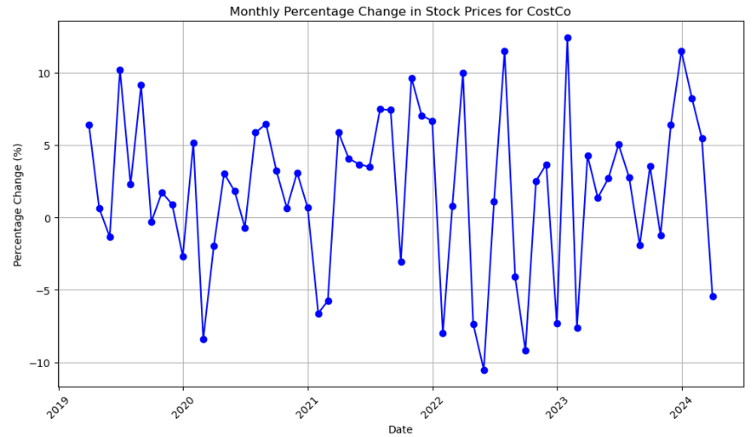
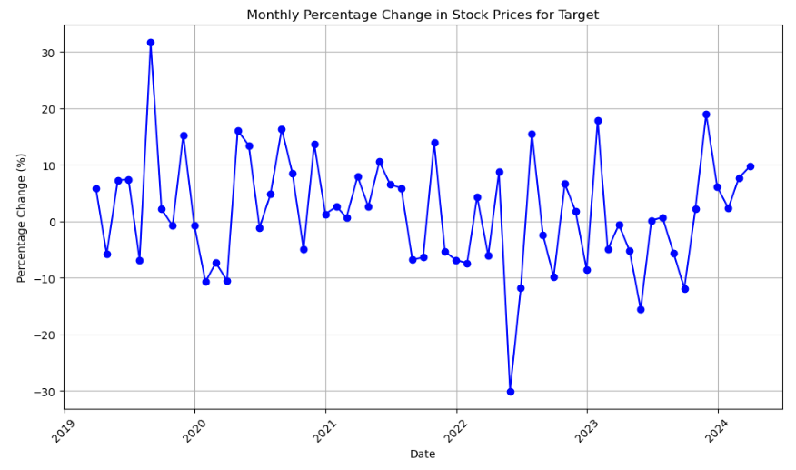
HOW DOES THE STOCK PRICE CHANGE OVER TIME?

Slide 9
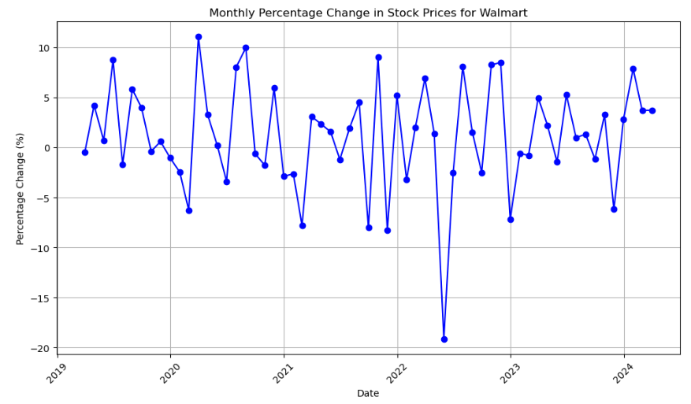
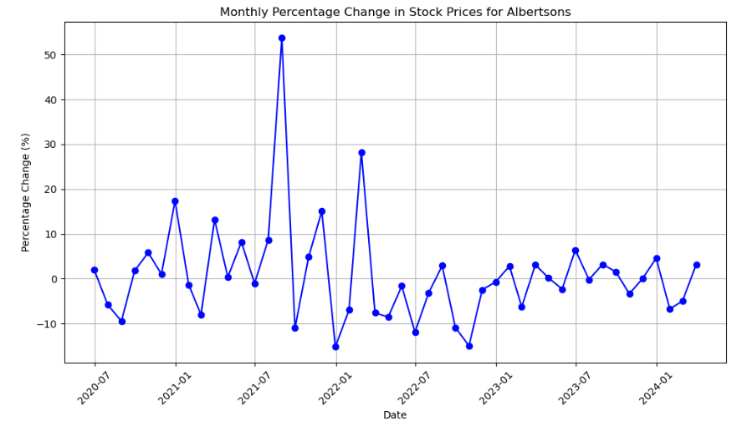
HOW DOES THE STOCK PRICE CHANGE OVER TIME?

Slide 10
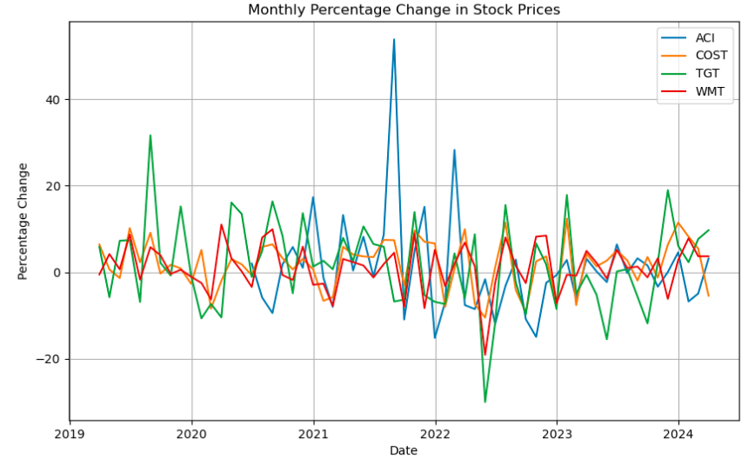
HOW DOES THE STOCK PRICE CHANGE OVER TIME?
NB – Albertsons has only been trading in its current form since Mid 2020

Slide 11
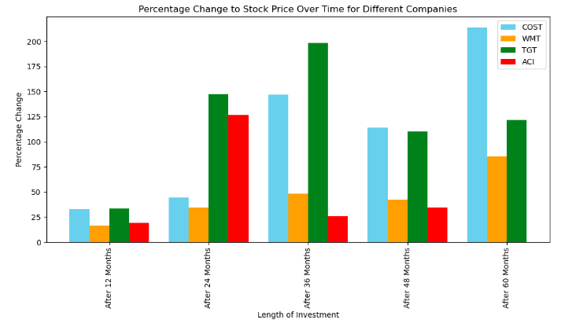
HOW DOES THE STOCK PRICE CHANGE OVER TIME?
Assumptions:
The original opening price was found and then compared to the closing price 12, 24, 36, 48 and 60 months later.
NB - ACI has not been traded in it’s current form for 60 months.

Slide 12
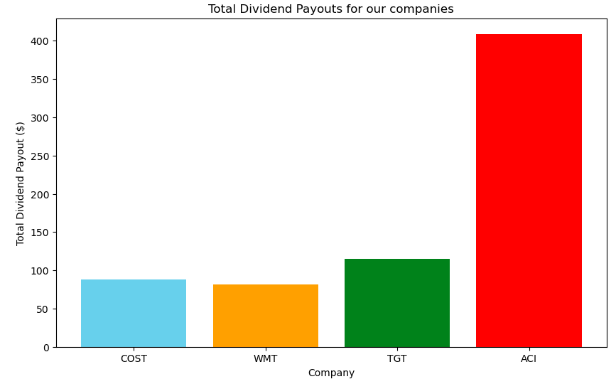
HOW ARE DIVIDENDS TREATED BY THE COMPANY?
Assumptions:
$1000 was used to buy shares.
The shares were not traded throughout the 5 year period – or for the period of time that Albertson’s was listed.
No additional shares were purchased.

Slide 13
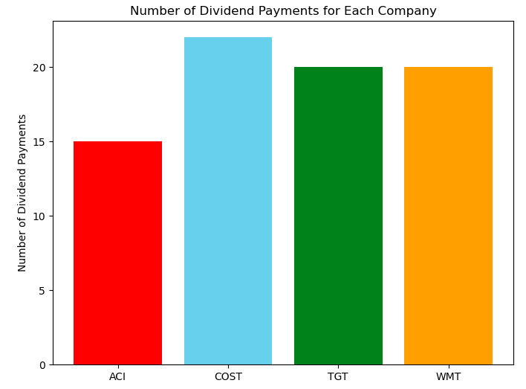
HOW ARE DIVIDENDS TREATED BY THE COMPANY?

Slide 14
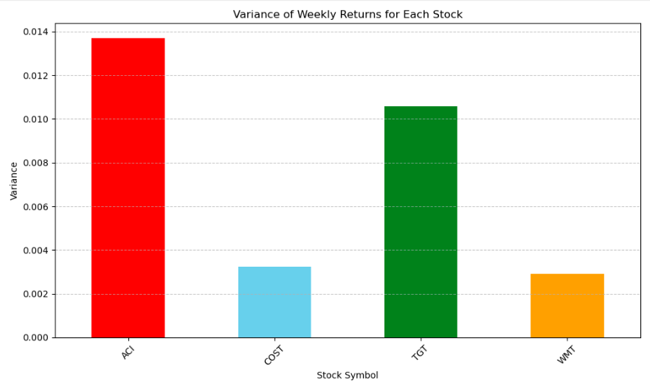
HOW VOLATILE IS THE STOCK?

Slide 15
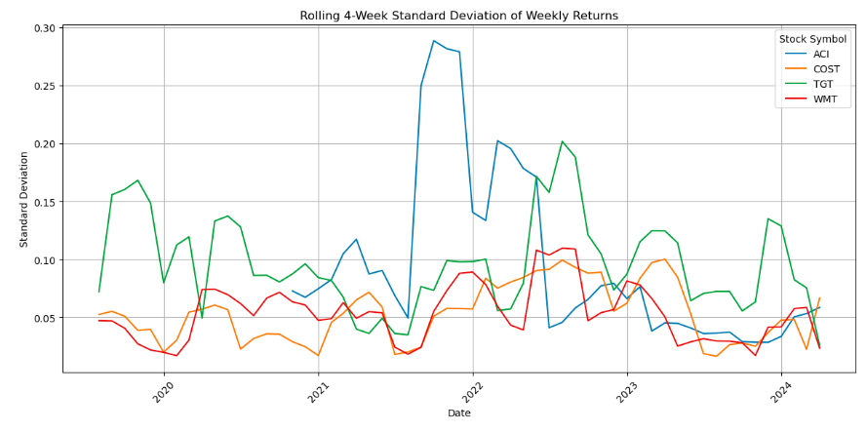
HOW VOLATILE IS THE STOCK?

Slide 16
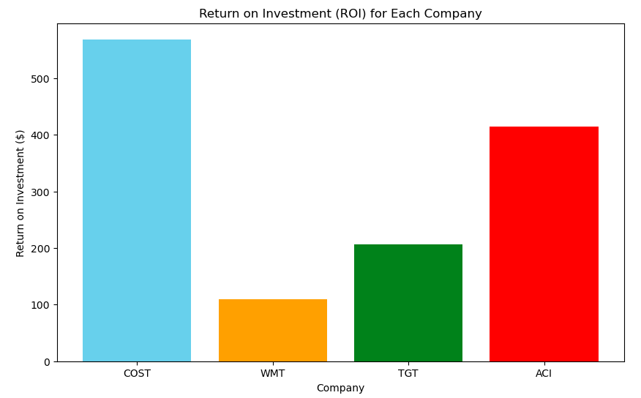
WHAT IS THE RETURN ON INVESTMENT?
Assumptions:
Initially $1000 was invested.
ROI is the sum of all dividend payouts and stock price increase over the 5 year period for all bar ACI.
ACI – the same operations were performed, but only for the time period that they are trading in their current form.

Slide 17
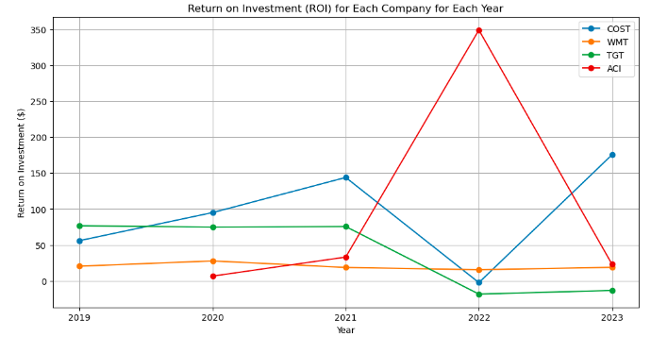
WHAT IS THE RETURN ON INVESTMENT?

Slide 18
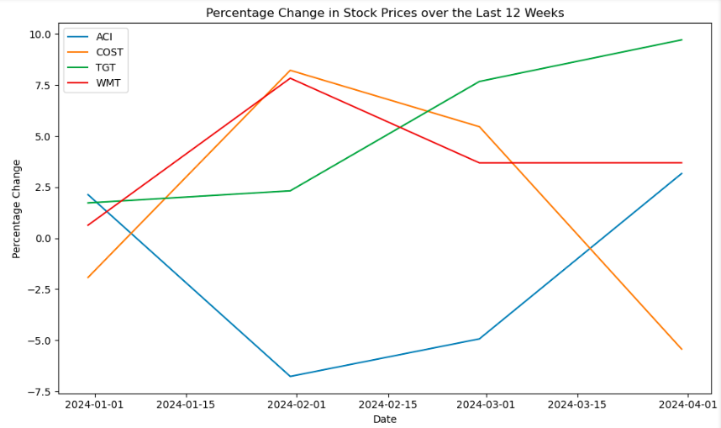
IS PAST FINANCIAL PERFORMANCE A TRUE INDICATOR OR FUTURE FINANCIAL PERFORMANCE?

Slide 19
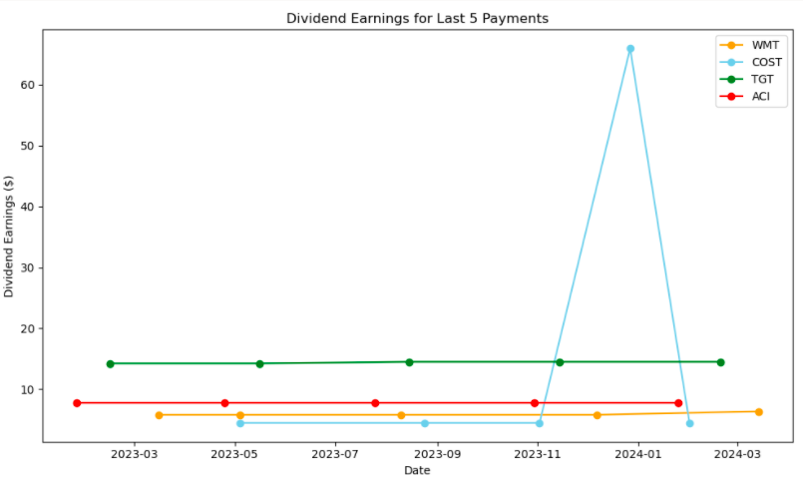
IS PAST FINANCIAL PERFORMANCE A TRUE INDICATOR OR FUTURE FINANCIAL PERFORMANCE?
Assumptions:
$1000 worth of stock was invested using the original opening price - and used to calculate the number of shares held.
Dividend earnings is the number of shares held multiplied by the dividend per share to give a total amount per dividend issue..

Slide 20
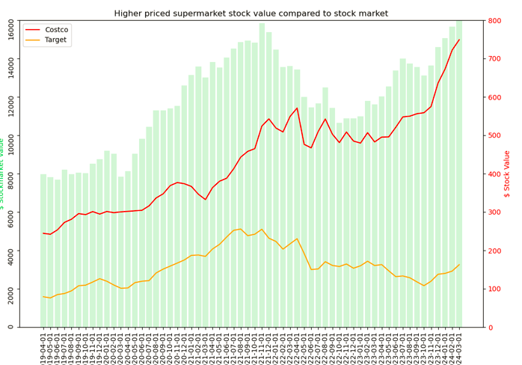
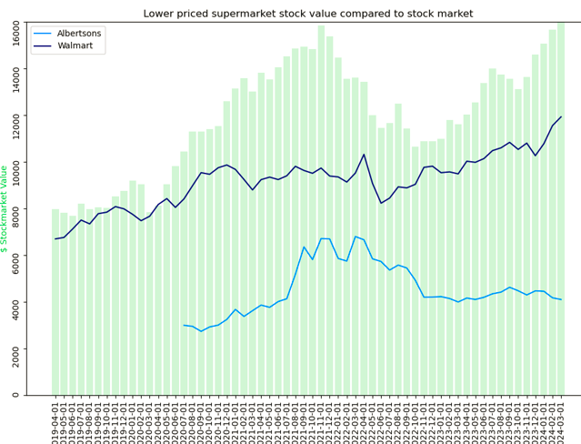
ARE THERE ANY OTHER FACTORS THAT CAN INFLUENCE OUR DECISION?

Slide 21
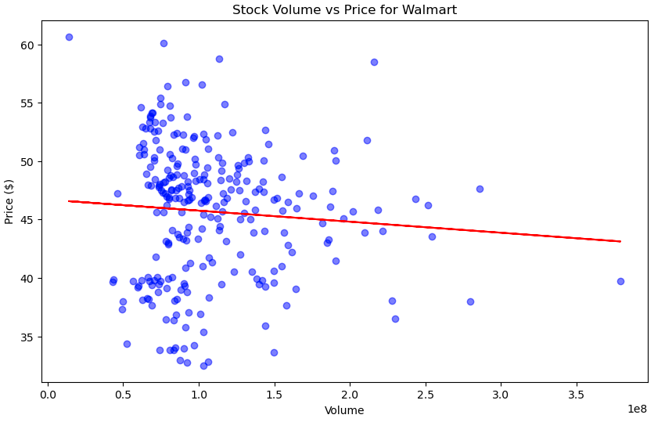
ARE THERE ANY OTHER FACTORS THAT CAN INFLUENCE OUR DECISION?
Correlation Co – efficients:
Walmart: -0.077
Costco: -0.151
Target: -0.272
Albertsons: -0.118

Slide 22
ARE THERE ANY OTHER FACTORS THAT CAN INFLUENCE OUR DECISION?
Walmart - aggressive expansion plans - will it work?
Albertson’s - implications of a blocked merger?
Costco - an over - reliance on membership numbers?

Slide 23
SO WHO SHOULD WE INVEST IN BASED ON THIS DATA?
Based on total ROI, it is hard to look past Costco!
This is in spite of in one year ROI was 0 - but for the other years, ROI was consistently above the other chains.
However, over the last 3 months, its share price has declined - do we think this is a pattern of things to come?
Total dividend payments are less relevant for Costco - its share price is a lot higher than the others so $1000 buys relatively less shares compared to the others - so the vast majority of any return is generated by the share price increasing.

Slide 24
FURTHER CONSIDERATIONS
Before any decision is made, further scrutiny of the company would need to be done – for example, examining the Trading Profit and Loss Account and Balance Sheet and performing other statistical measures such as the “Acid Test”.
What is your investor / risk profile? Are you a Pension Fund Manager or a day trader? A Day trader may be prepared to absorb a higher level of risk than a Pension Fund Manager who has to ensure that any trades will cover their commitments no matter what.
Are there other sectors who are greatly outperforming this one – and would be a more attractive investment opportunity?

